Slide 1
Human–Computer Interaction
Usability principles and design guidelines
Ann Blandford

Slide 2
Aims of this session
By the end of this session, you should:
  Be aware of a range of usability design principles and of how they can be applied in design.
  Be able to consider existing systems in terms of the same principles

Slide 3
Overview of principles (1)
Visibility
  What is and is not visible about the system state (of relevance to user)
Feedback
  Enabling user to see effect of actions
Constraints
  Limiting possibilities in sensible ways

Slide 4
Overview of principles (2)
Mapping
  Relating controls to their effects in the world
Consistency
  Using similar elements to achieve similar tasks (and the converse too…)
Affordance
  Object communicates possible actions

Slide 5
Visibility
Information that matters to the user is displayed clearly.
In a format that is meaningful to user.
E.g. Facebook:
  I am never sure whether I’m sending a message just to one person or publishing it for all my friends to see
  Notification of friends’ birthdays is usually off the bottom of the screen
  What else?!?

Slide 6
Feedback
Must be informative
  May be tactile, graphical, textual, audible, etc.
Must be timely
  E.g. my TV…
Give examples of good and poor feedback from your own experience.

Slide 7
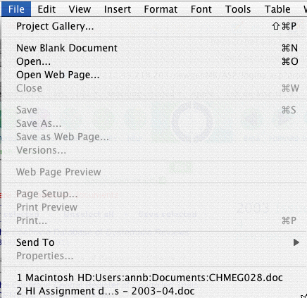
Constraints
E.g. greying out non-viable options
Creating connectors that only fit the right way (cf some medical accidents)

Slide 8
Mapping
Also known as ‘stimulus-response compatibility’
E.g. draw the layout of the controls for your hob.
  How easy is it to remember which knob controls which ring?
E.g. solitaire controls on my ipod…

Slide 9
Consistency
Use similar options and similar elements for achieving similar tasks.
Use similar layout, colours, etc. to convey similarities.
Use contrasts to convey differences.
  Beware habituation
  Cf indicating with the windscreen wipers…

Slide 10


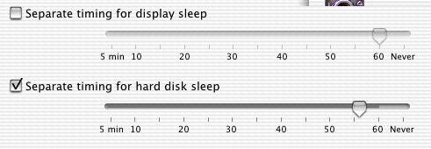
Affordance (Gibson)
Many objects in the world communicate what can be done with them by their shape and appearance.
Notes:
For future reference: this slide really didn’t fit well in this lecture – move to week 3.

Slide 11
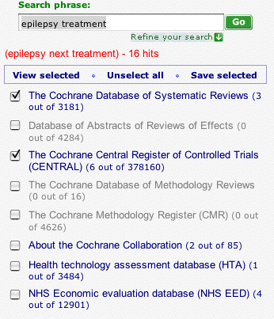
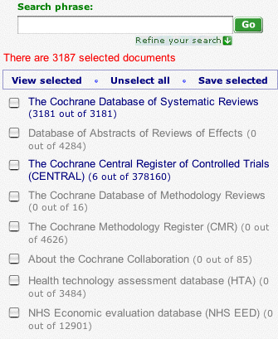
One more principle: predictability
User should be able to predict effect of next action. E.g. what’s the effect of selecting “view selected” here?
Uh???

Slide 12
Design guidelines
Generally more detailed than principles
E.g. style guides for different systems
  Often help to ensure consistency of interaction
E.g. W3C Accessibility guidelines
  http://www.w3.org/TR/WCAG10/

Slide 13
Summary
Principles such as visibility, feedback, constraints, mapping, consistency, affordance and predictability can be used to guide design or evaluate existing designs.
Principles need to be applied with intelligence!
‘Negation’ of principles can also be used to convey meaning.
Design guidelines, particularly accessibility guidelines, help make interfaces more usable.

Slide 14
Questions or comments?
Read:
Sharp, H. Rogers, Y. & Preece, J. (2007) Interaction Design. 2nd Ed. Wiley, New York. Chapter 1

